Slide 1

Prediction Of Revolving Credit Balance
Team Name-Group1
Mentor Name-Munnum
DD/MMM/YY-17-7-2020
SivaKrishna Yadav Joga
Noonela Divya
Vimal Patel

Slide 2
Project Architecture / Project Flow
Business Problem
Data Cleansing
Exploratory Data Analysis
Model Evaluation
Model Building
Feature Engineering
Model Deployment

Slide 3
Business Problem:- Bank offers revolving balance to the customers in doing so they can charge higher interest rates so there is lot of risk associated in customer repaying the amount. So here our bank wants to predict the revolving balance maintained by the customers. Objective:- The objective is to predict the revolving balance maintained by the customer.

Slide 4
Exploratory Data Analysis (EDA) Steps For EDA:- 1)Describe the number of Rows and Columns in the dataset 2)Cleaning the Data 3)Finding the Missing Values and imputing them 4)Converting the data types to unique format. 5) Created bin for better understanding of data. 6) Univariant analysis of data using Histogram,Barplot,violin plot, 7) Used heat map for understanding the colinearity problem between dependent and independent variables.

Slide 5
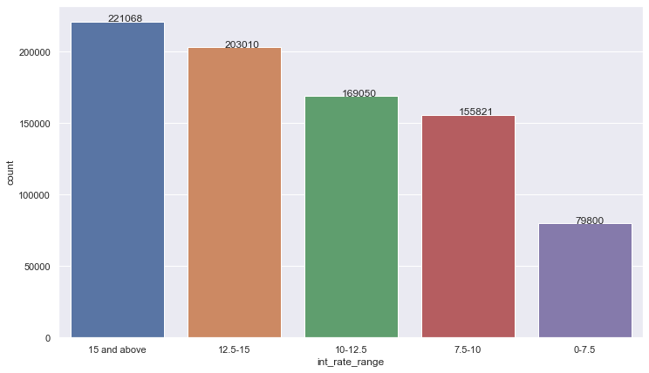
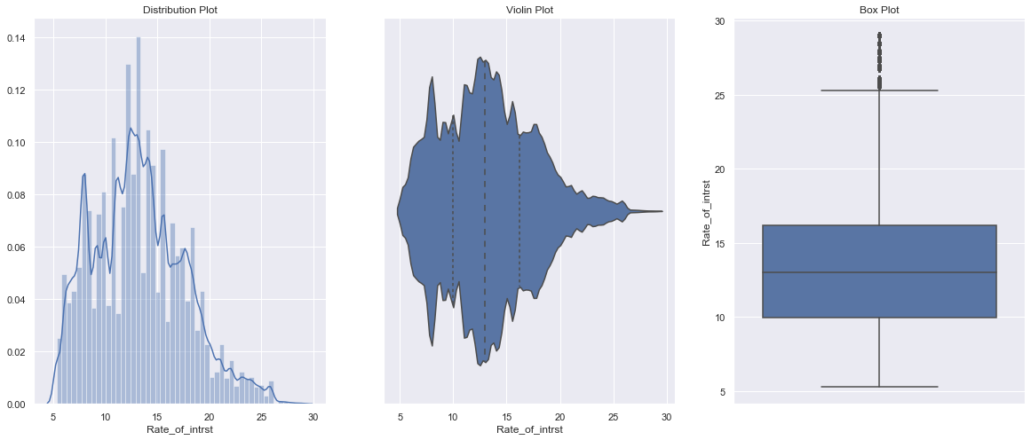
Interest rate change. 1. To observe the interest rate change we created bins and observed that there are 221068 customers having15 percentage and above. 2. 203 010 customers have interest rate of 12.5 to 15 percent. 3. Most of our customers have interest rate 12.5 and above.
Our data shows that most of the customers are availing interest rate of 15 % above and they maintaining a revolving credit balance of 5000 and above so

Slide 6
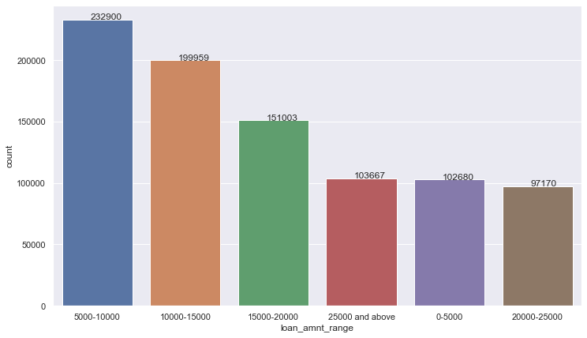
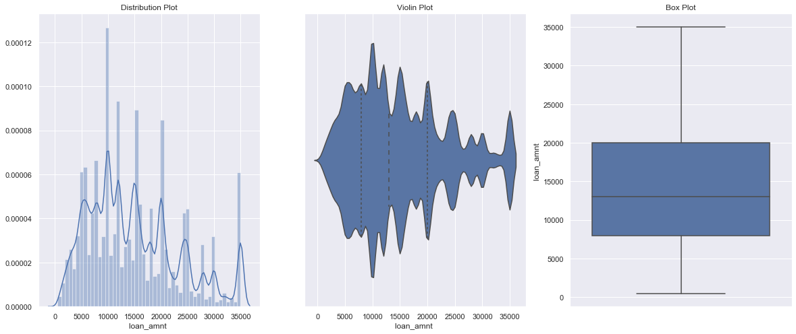
Loan Amount 1. It can be inferred that most of the customers take loan amount between 5000 to 20000 and there are 232900 customers taken loan amount of 5000-10000 & 199959 customers taken loan amount between 10000-15000.

Slide 7
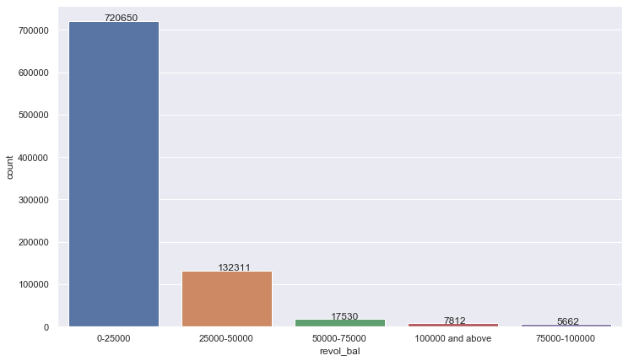
From the plot it is seen that most of the customers maintain revolving credit up to 25000

Slide 8
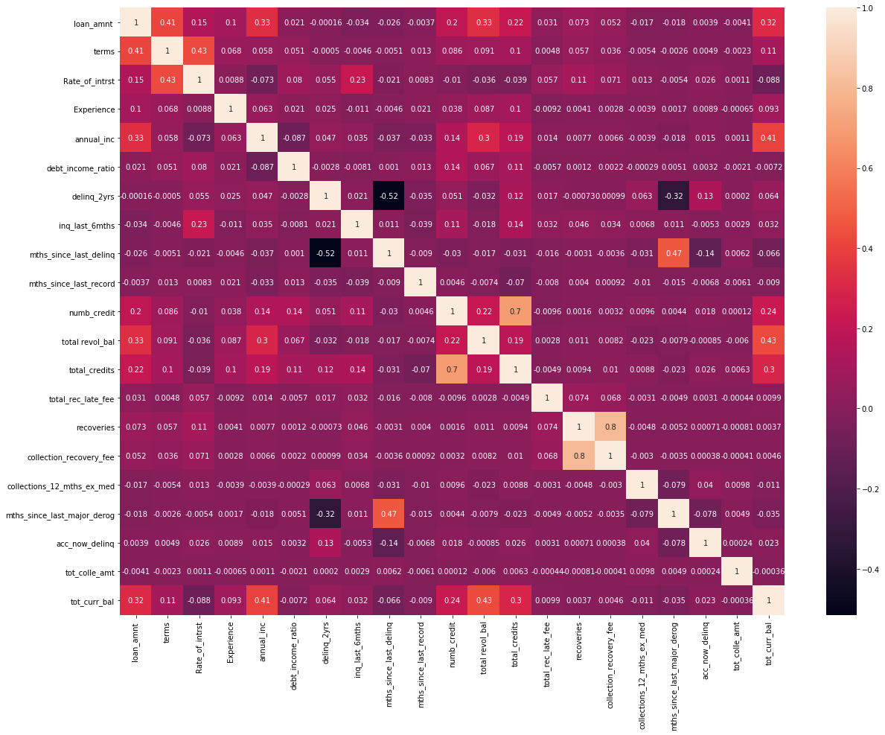
To understand the correlation by heat map

Slide 9
Model | Multilinear Regression
RMSE Train | 0.0065
RMSE TEST | 0.0081
RMSE_Data | 0.0066
Model | XGBooster
RMSE Train | 129940741.48
RMSE Test | 157353836.00
RMSE data | 131913279.80
Model | Random Forest
RMSE Train | 15751.5572
RMSE Test | 18070.9093
RMSE Data | 16126.1451

Slide 10
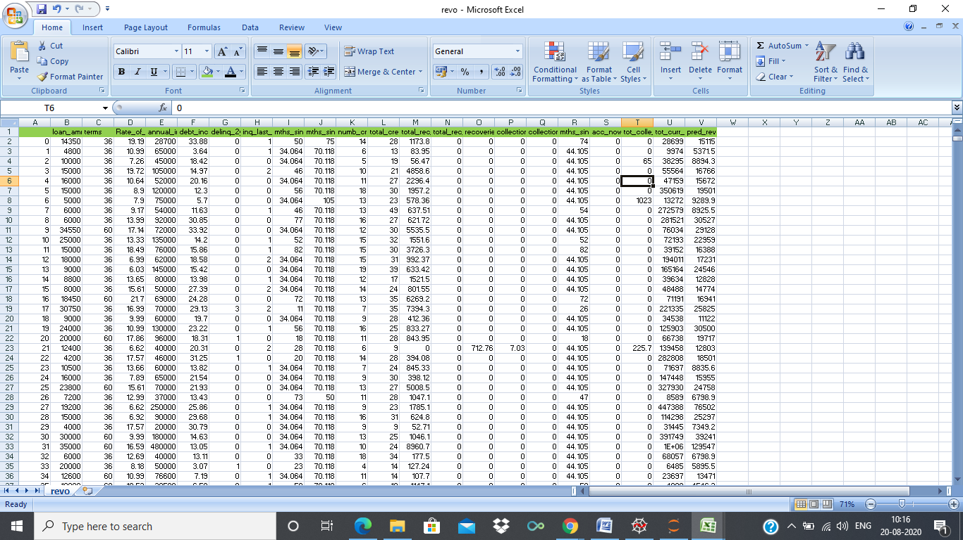
Model Predictions
model

Slide 11
Model Results
We have used Multilinear regression model ,Xgb booster and Random forest models for our data and found that by using random forest model we got least rmse values. we have tuned the hyper parameters for better results and got the final results
Rmse train-15751.5572
Rmse test-18070.9093
Rmse data-16126.1451

Slide 12
Challenges Faced:
Identifying different models in building algorithm
Reduced the under fit problem by using different models
How did you overcome:
Tried different models to improve the Rmse
Done Lots of Secondary Research
Tuning of Hyper parameters.

Slide 13
Thank you

